Slide 1

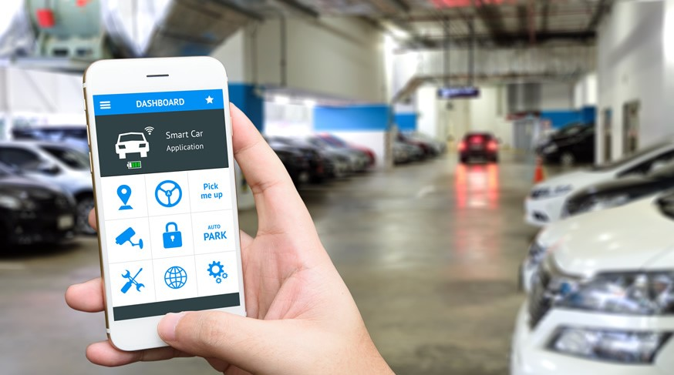
Smart Attend
Vipra
Parking Management System
Team Members:
Dharani Muli – Team Lead
Neha Navgale
Naveena Madepally
Chakra Pavan Kumar Kota

Slide 2
Highlights and Value addition:
Provides electronic monitoring and management of parking facilities.
Web application to electronically creates parking lots and allot permits to customers in parking lot.
It interfaces with patrolling information to track violation of parking allotment and track unauthorized parking using mobile app.
Mobile app to scan constantly and read License Number plates using computer vision.
Validate license number plates with authorized customers details.
Track violation if any.
Smart Attend

Slide 3
Brief about our application:
Web Application:
Below type of users can login to their respective tasks
Parking App owner
Parking Organizations Admin
Manage Parking Organizations
Add new “Line of Business” (Parking Organization)
Create an account for Organization Admin
View lists of Line Of Business
Manage Locations
Add parking locations by searching for the location and spotting the location on google map for their respective organization
Add slots and parking violation charges to each parking location.
View lists of parking location at your organization and number of slots occupied and available
Smart Attend

Slide 4
Brief about our application: (Continuation…..)
Web Application:
Manage Patrol Users
Create an account for Patrol Users who can patrol the parking areas
View list Patrol users of your respective organization
Manage Customers
Create permits for the Customer by adding information of users, vehicles and locations allotted for the parking along with the cost
View the list of permits
6. Manage Tickets
Dashboard for Admin to view below information of daily, weekly, monthly and yearly for Organization Admin
Number of Permits created
Number of slots available
Smart Attend

Slide 5
Brief about our application: (Continuation…..)
Mobile Application:
Patrol user can login for parking patrolling
Create an account for Patrol User who can patrol the parking areas
View list Patrol users of your respective organization
Start patrolling by continuous scanning of car number plates.
App will identify the License Plate number and will check if vehicle has active permit or not.
Record the details for any violation.
Smart Attend

Slide 6
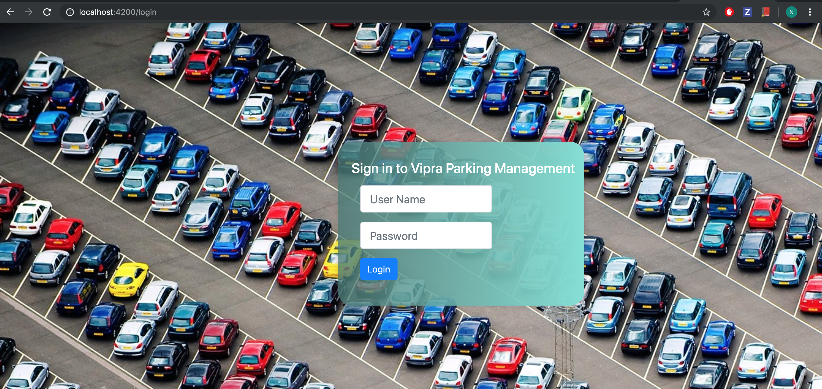
Login Page
Smart Attend

Slide 7
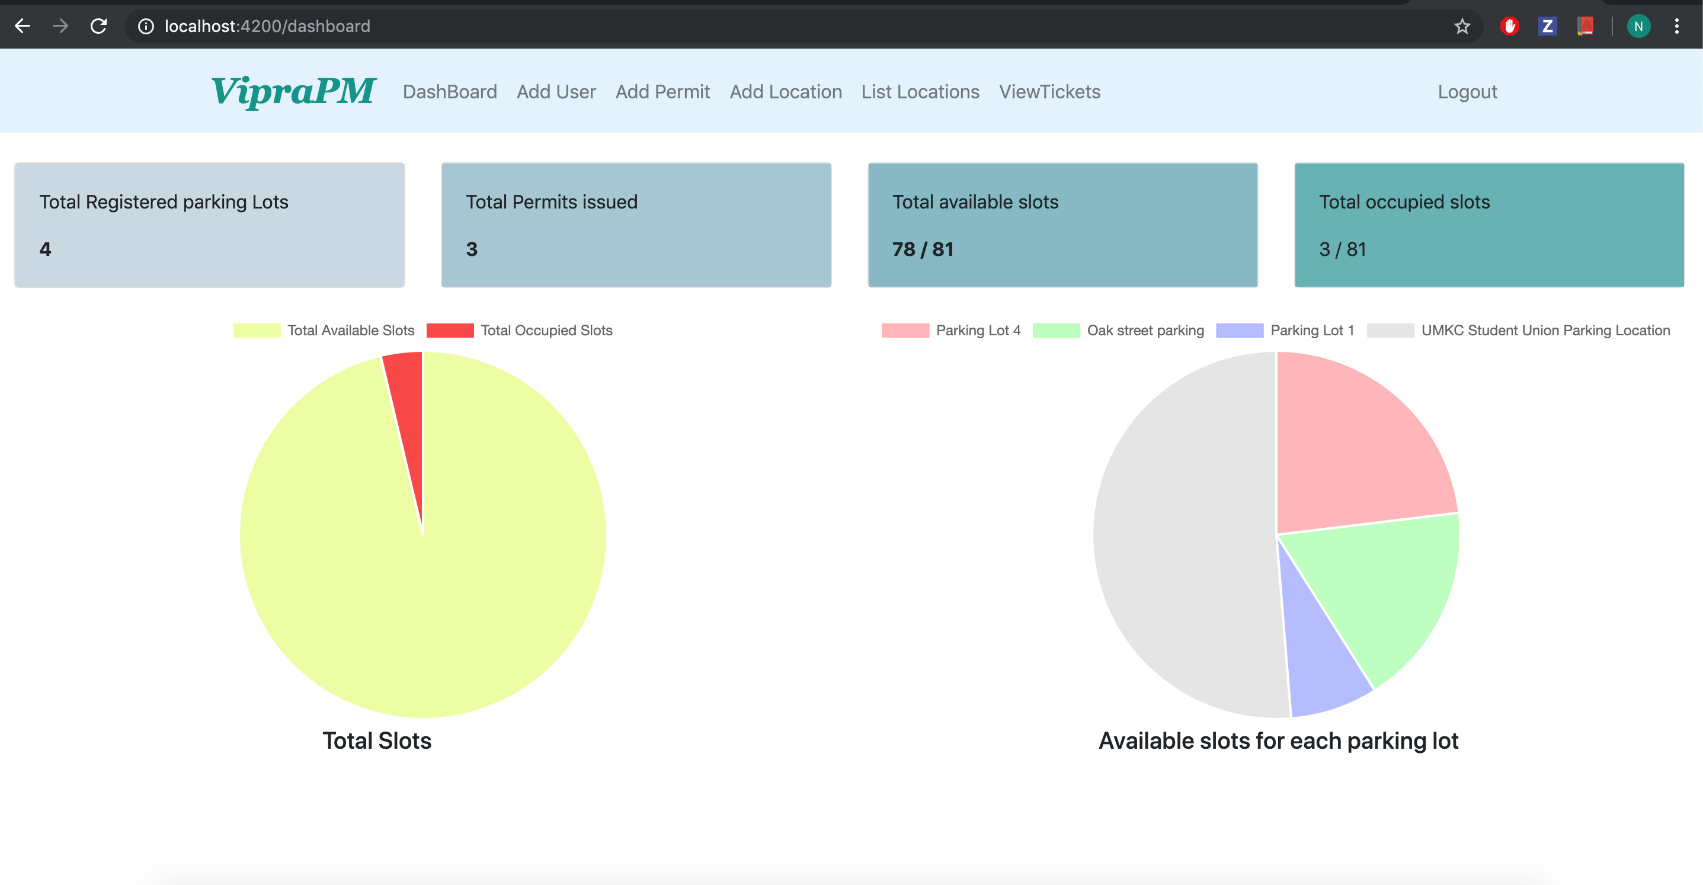
Admin Dashboard
Smart Attend

Slide 8
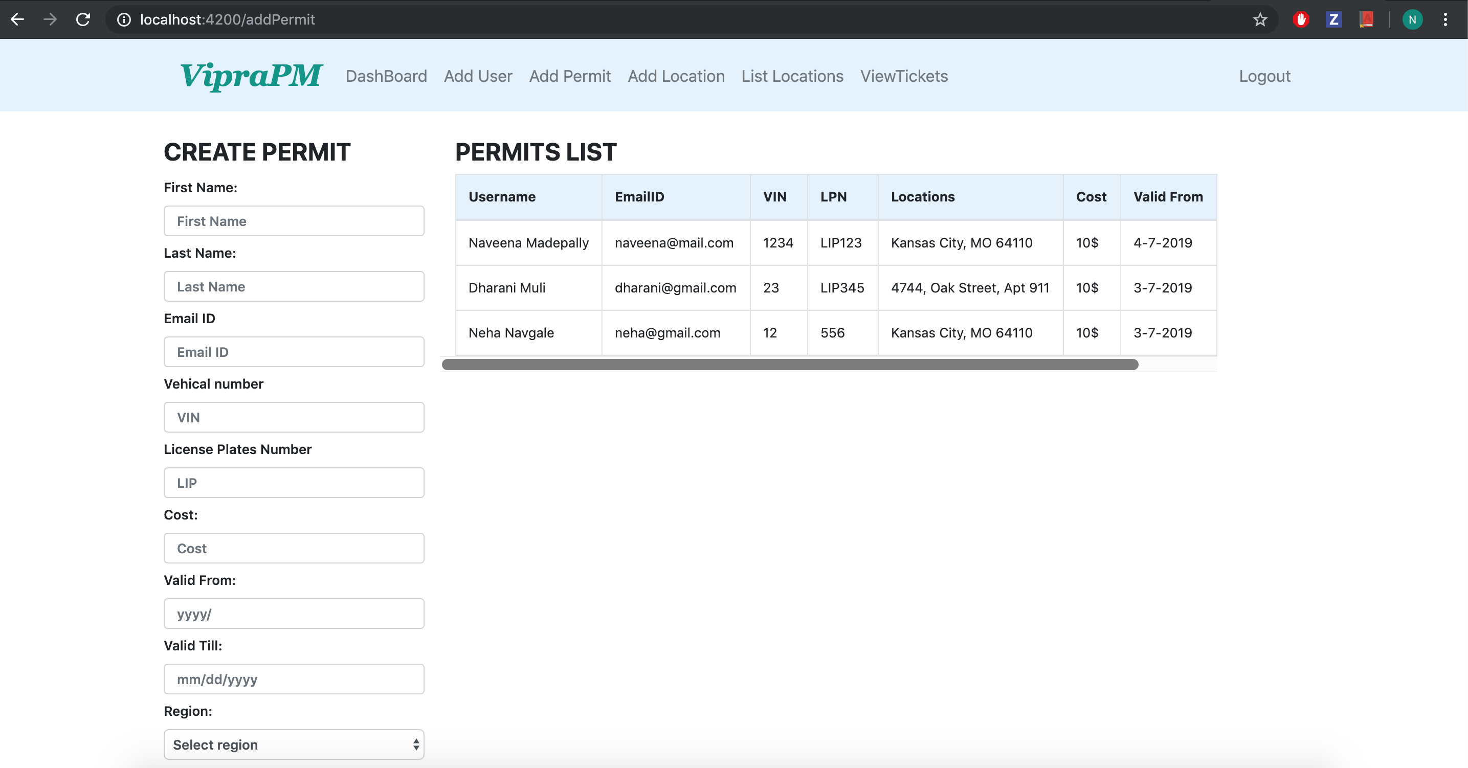
Add customer and give permit
Smart Attend

Slide 9
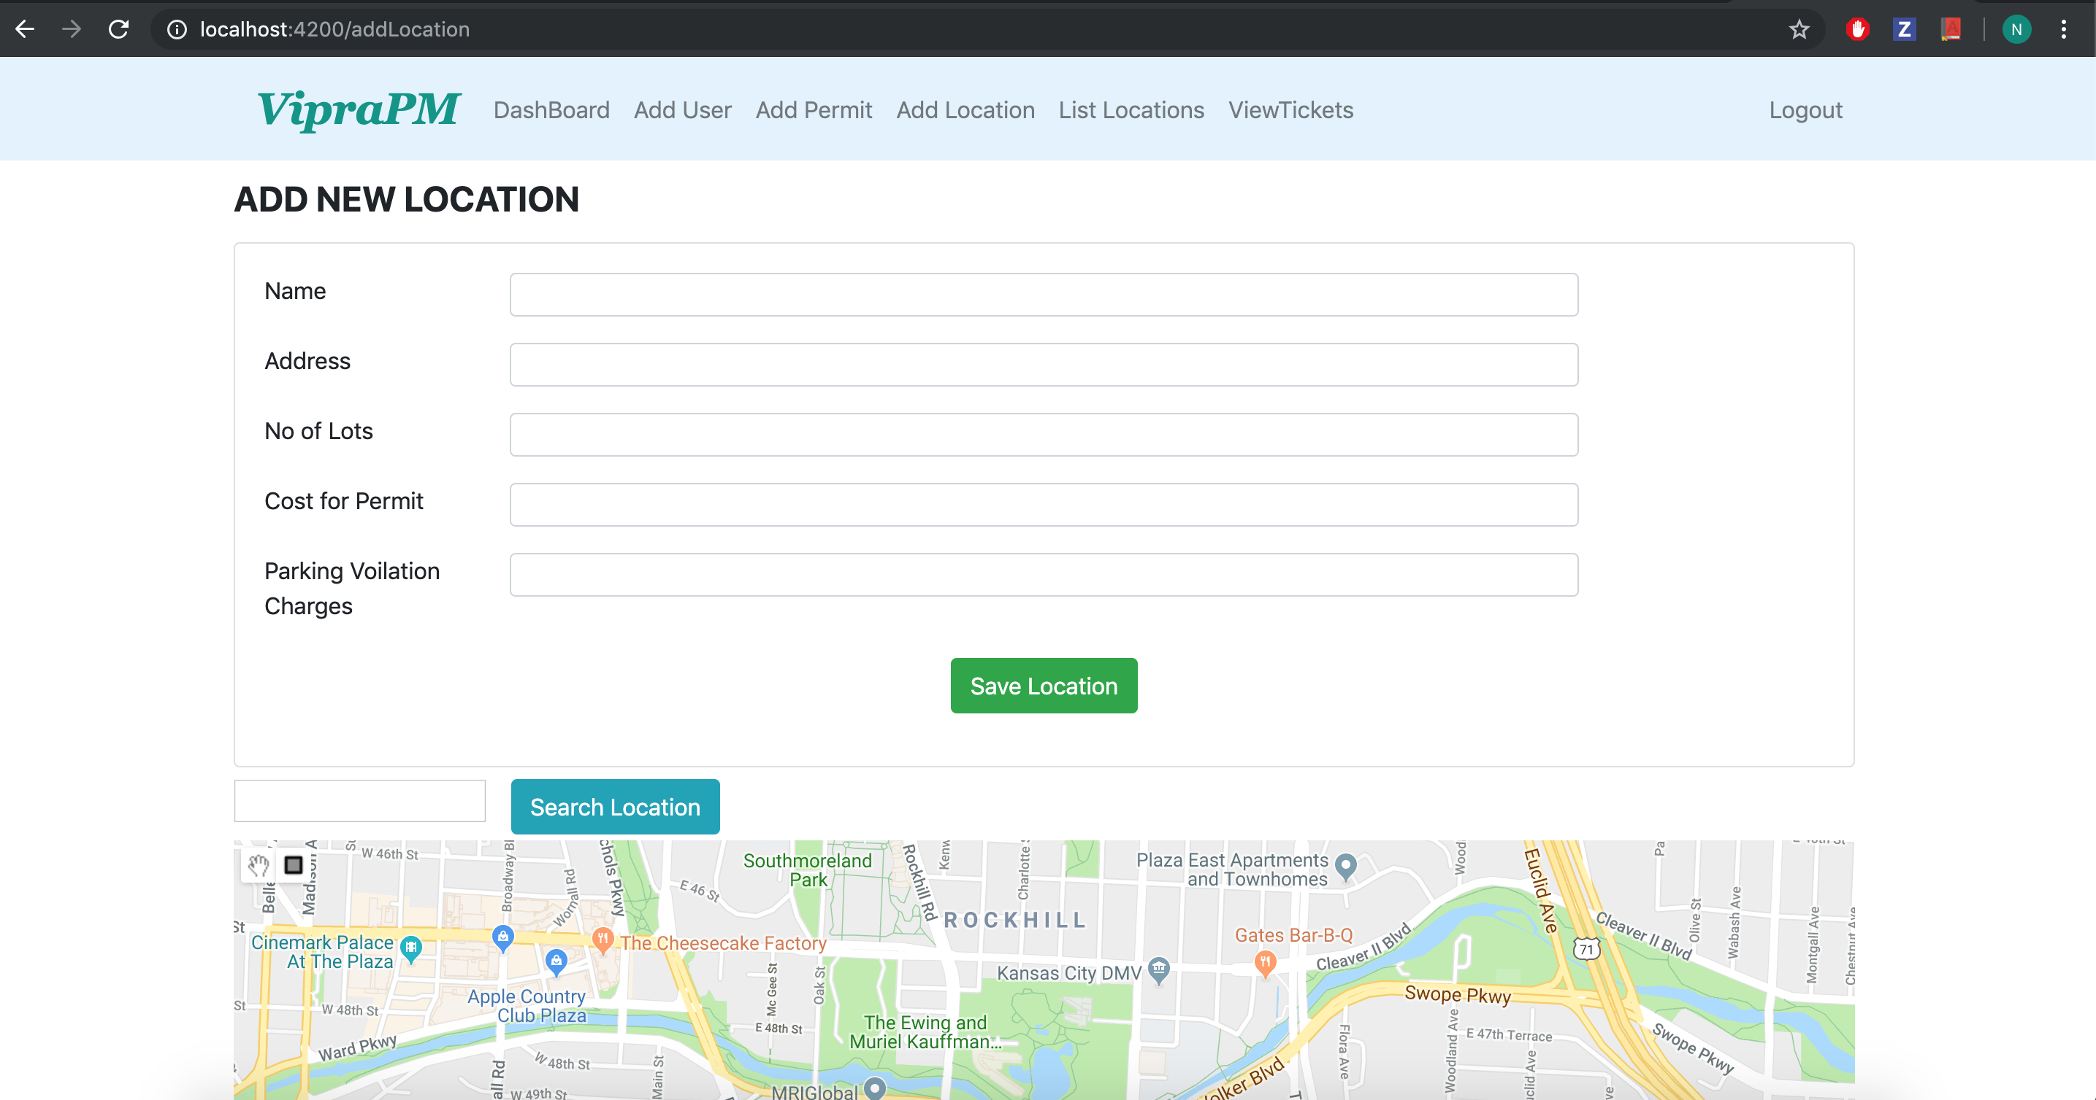
Add location of Parking Lot
Smart Attend

Slide 10
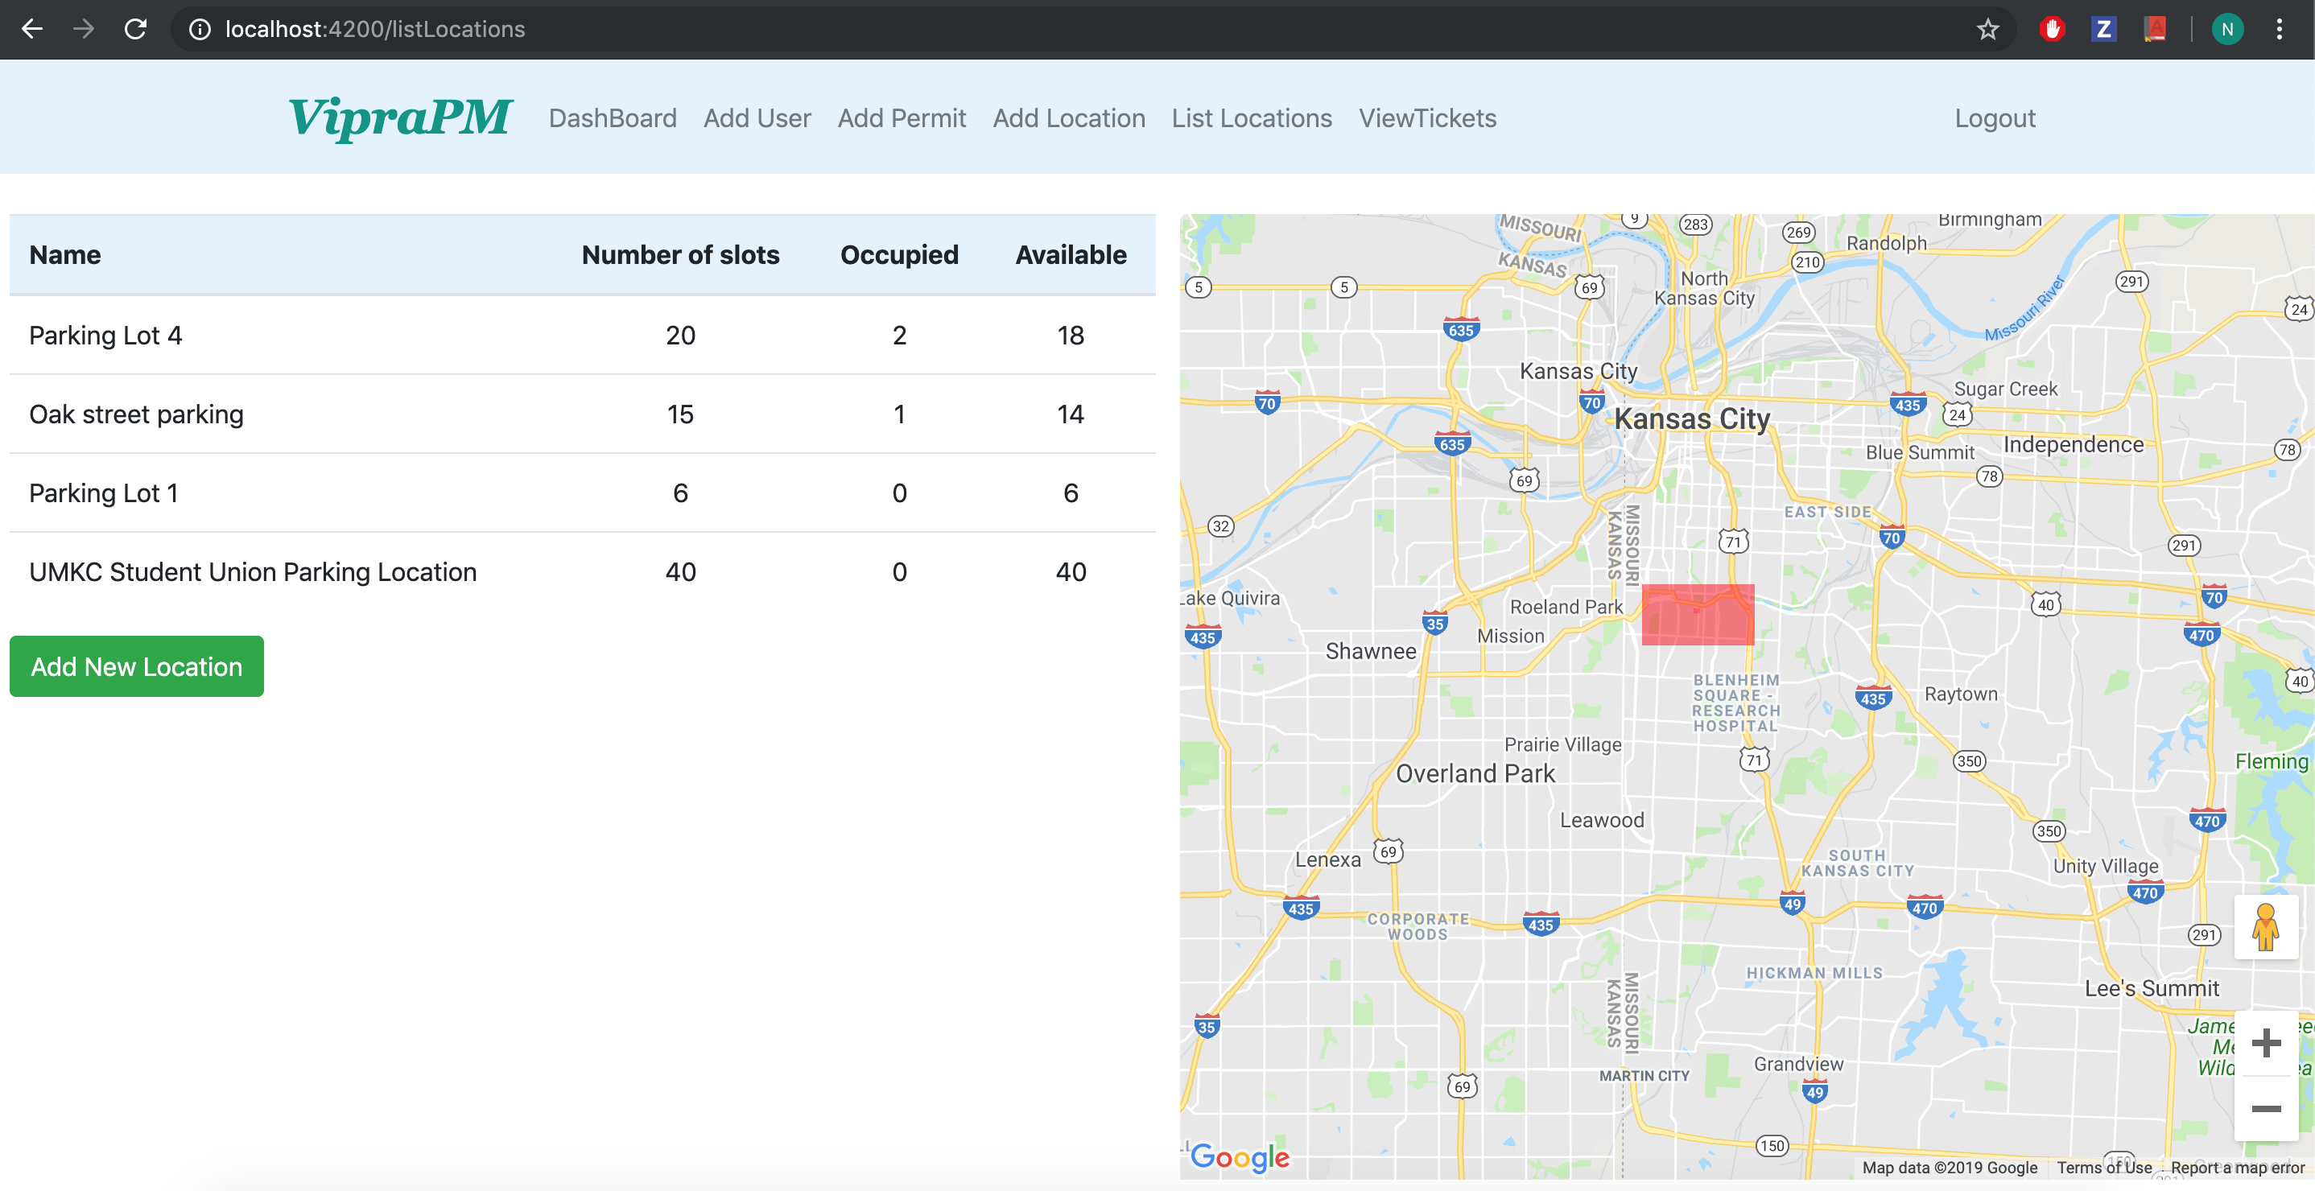
Manage locations of Parking Lot
Smart Attend

Slide 11
Manage locations of Parking Lot
Smart Attend

Slide 12
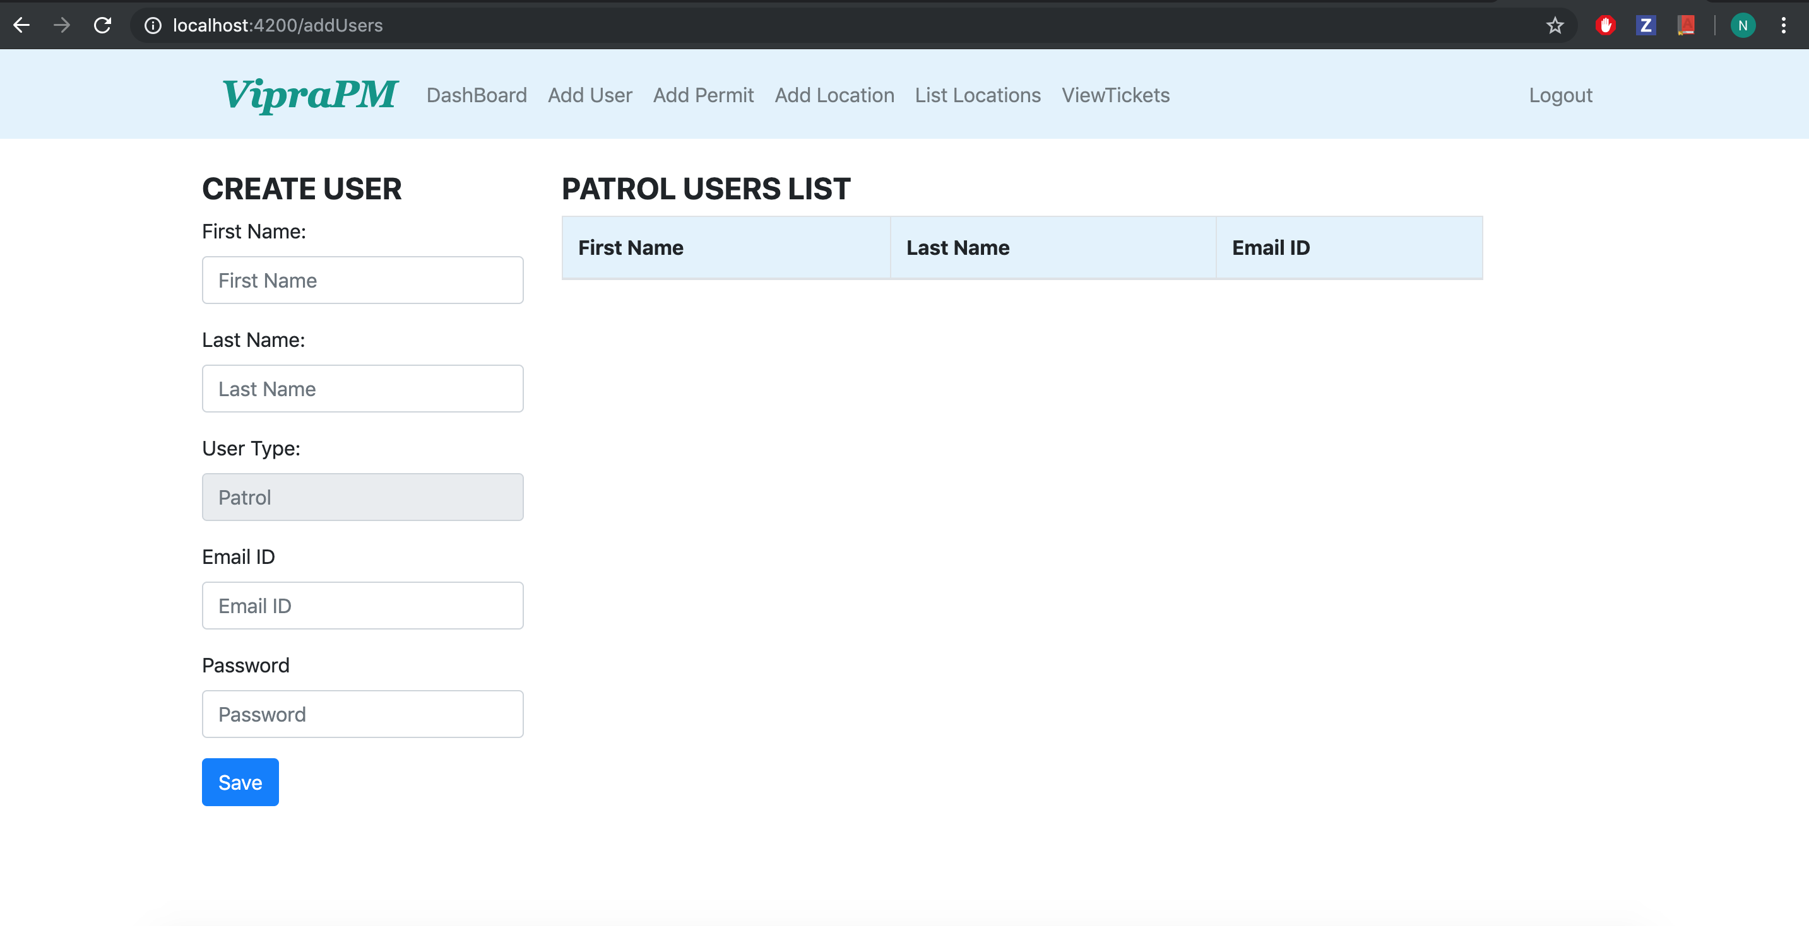
Add patrolling user
Smart Attend

Slide 13
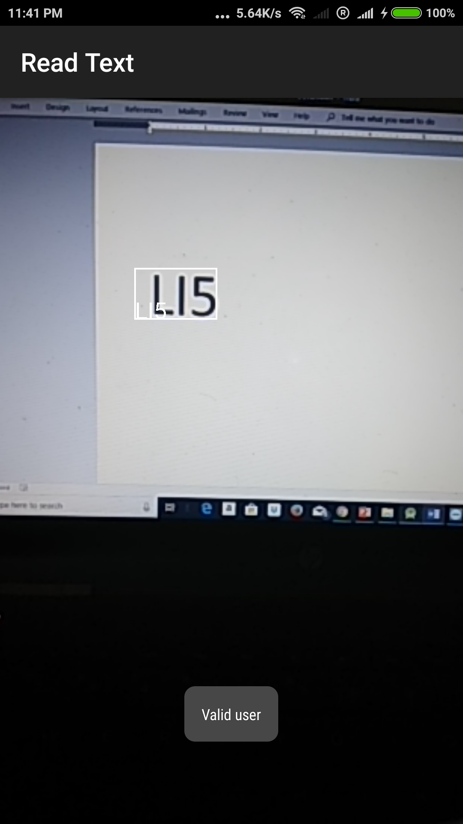
Mobile App (Validate Number Plate)
Smart Attend

Slide 14
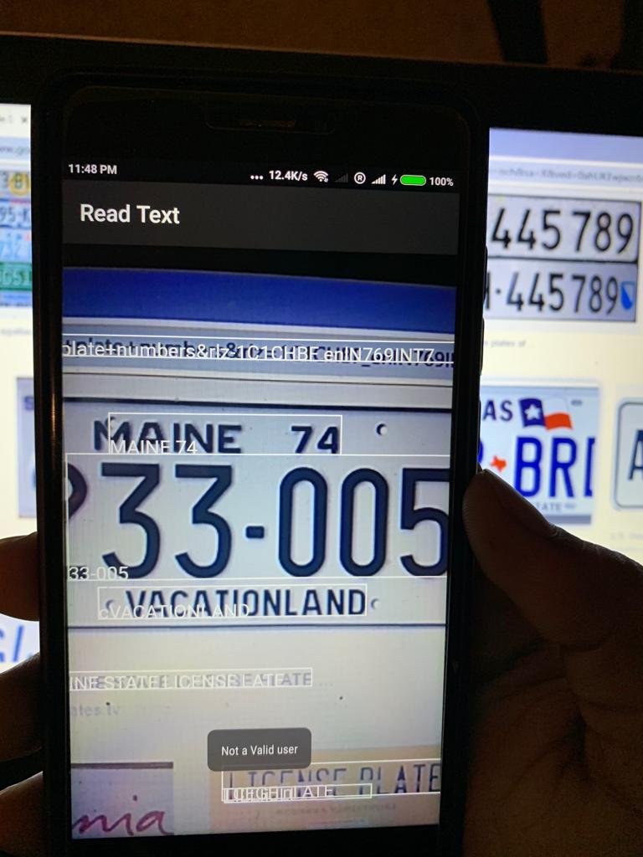
Mobile App (Unauthorized Number Plate)
Smart Attend

Slide 15

Tools, Languages, Platforms:
Ionic 4
Mongo DB
Html5, CSS3, SCSS
Angular 7
Node.js
Express.js
Android SDK
AWS

Slide 16
Thank you

